Slide 1

Air Quality Monitoring Dashboard
Using Real-Time Data from the IQAir API

Slide 2
Project Overview
Develop a user-friendly dashboard to monitor air quality in real-time.
Fetch data using the IQAir API.
Visualize air quality metrics with interactive charts.
Provide insights to improve awareness of air pollution levels.

Slide 3
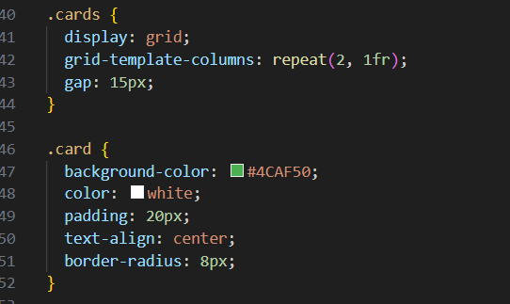
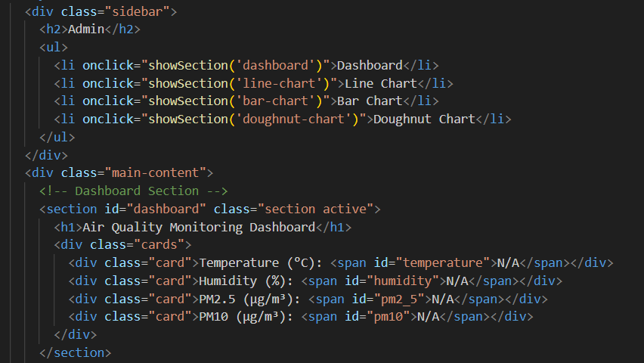
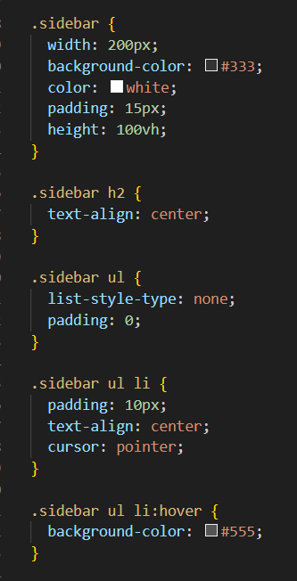
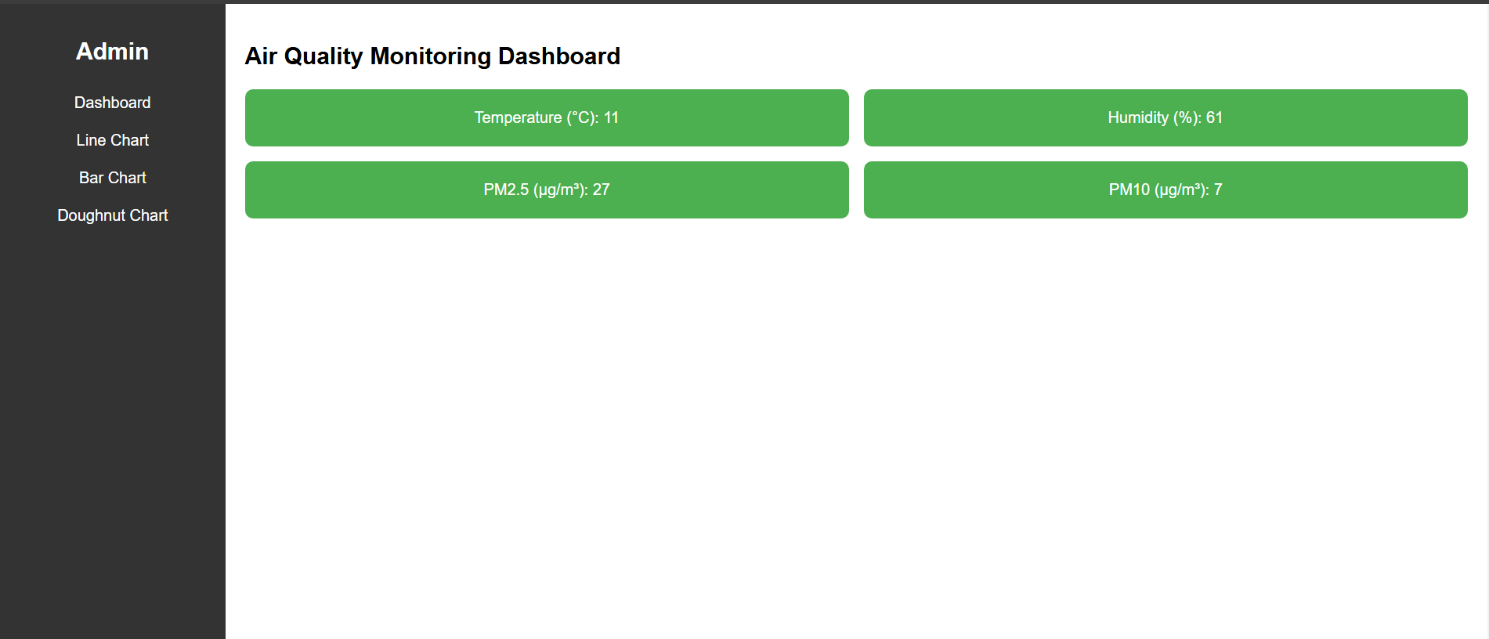
User Interface: HTML and CSS
The interface is built using HTML for structure and CSS for styling.
The goal was to create a clean, intuitive, and responsive design.
Key features include:
Navigation bar for switching between metrics.
A main dashboard area for displaying real-time data.

Slide 4
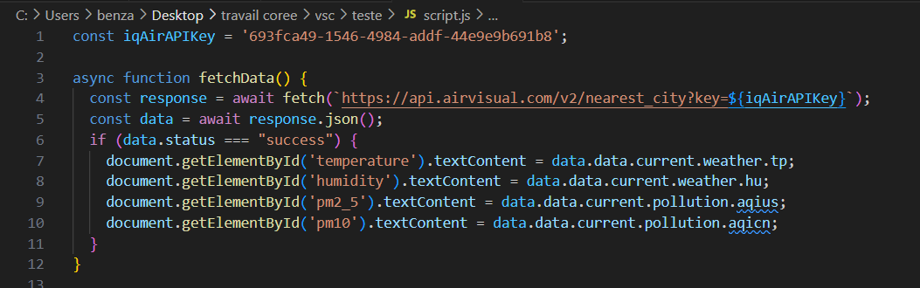
Using IQAir API for Data Collection
Function used: fetch()
The API provides real-time data on air quality, including:
PM2.5 and PM10 levels.
Main pollutants.
Air quality index (AQI).
The script handles API calls, processes JSON data, and updates the dashboard dynamically.

Slide 5
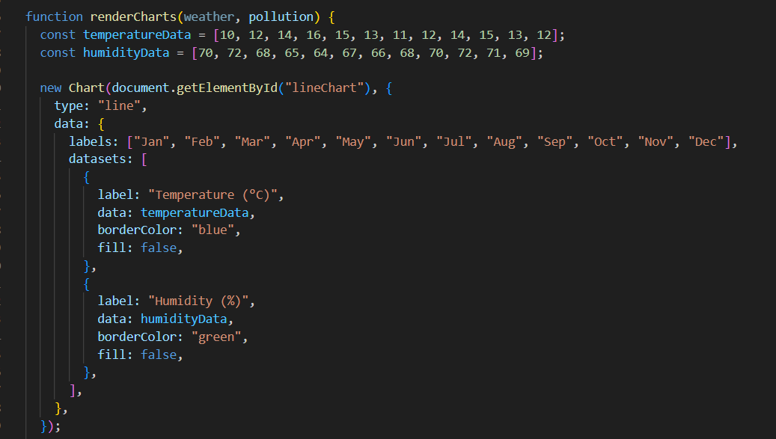
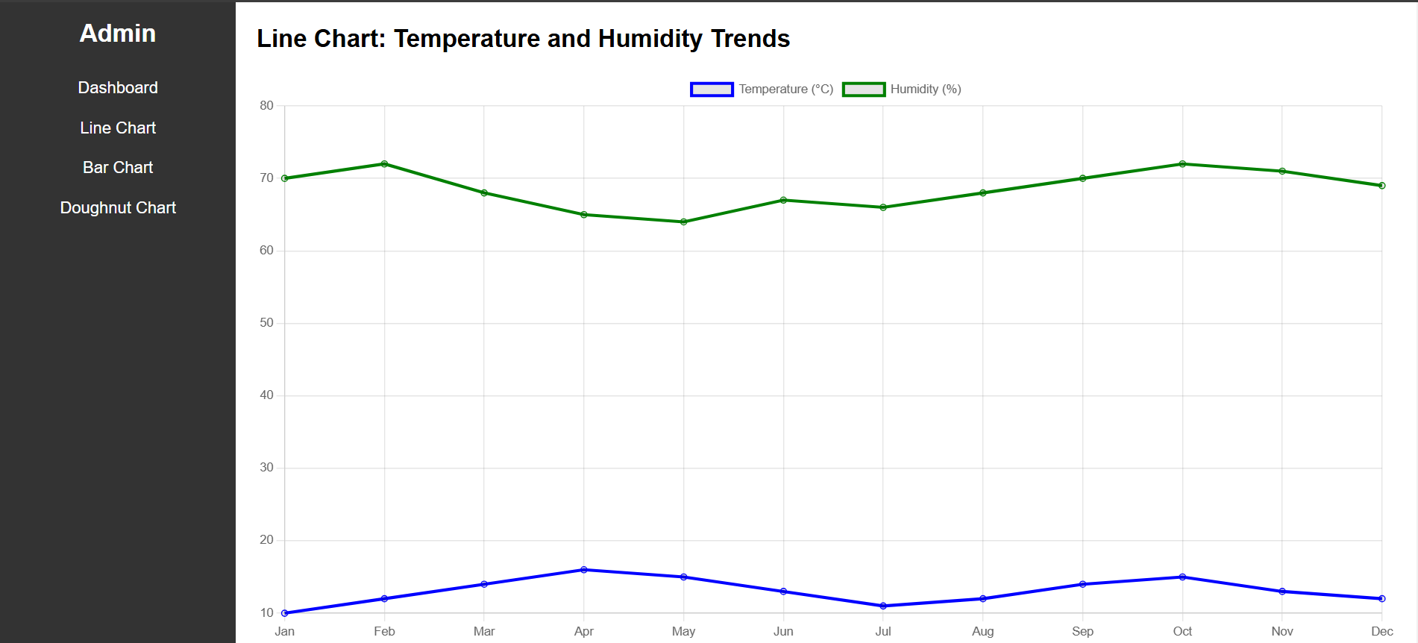
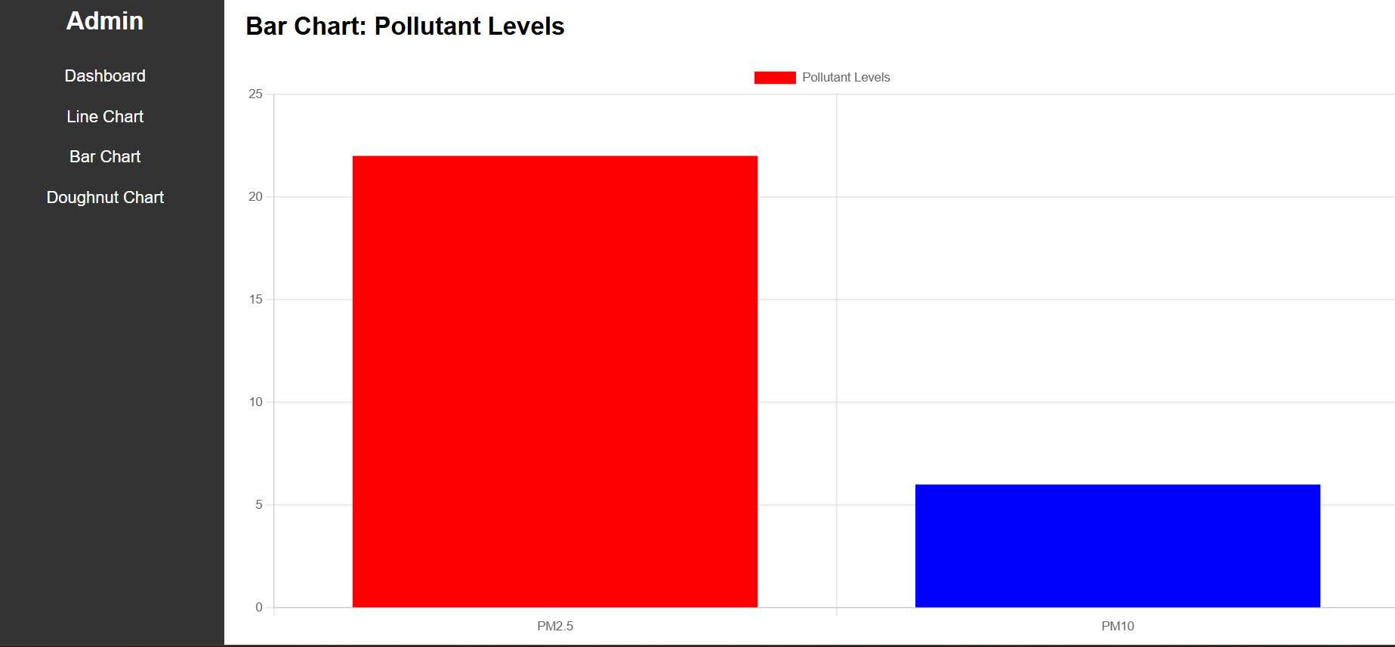
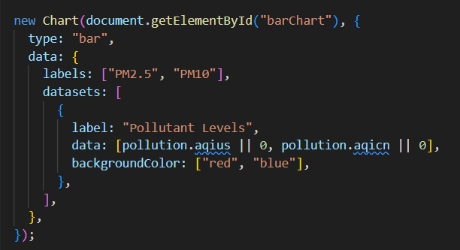
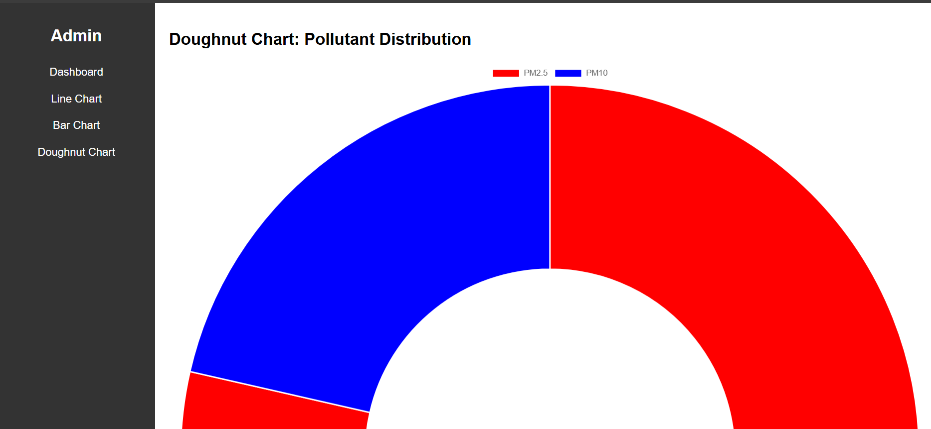
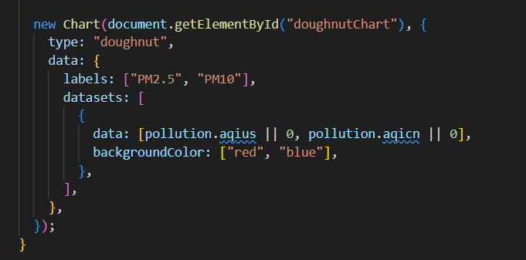
Interactive Charts with Chart.js
Line Chart: Displays AQI trends over time.
Bar Chart: Shows PM2.5 and PM10 levels across locations.
Doughnut Chart: Represents pollutant composition.
Key Functions:
Chart() initializes the visualizations.

Slide 6
What is Missing in My Project?
Accurate Data for Key Pollutants:
Accurate data for NOx, NH3, CO2, SO2, and VOC.
Solution Plan:
Obtain additional API keys to fetch real-time and reliable data for these pollutants.
Once this data is acquired:
Integrate it into the dashboard and update the various charts and visualizations shown earlier.

